Slide 1

Microsoft’s Summer of Nightmare vulnerabilities
Jason A. Kinder
@Jakinder
https://www.linkedin.com/in/jkinder/

Slide 2
WHOAMI
Director of Cyber Security Operations for Leonardo DRS
23+ years of experience in IT & Security
Blue Teamer/Network Defender
Focus on Incident Response, Security Architecture, Forensics, Insider Threat
Bourbon, Beer, Running, Hiking & Music are some of my passions

Slide 3
disclaimer
“The opinions expressed in this presentation and on the following slides are solely those of the presenter and not necessarily those of the presenter’s employer. The presenter’s employer does not guarantee the accuracy or reliability of the information provided herein.”

Slide 4
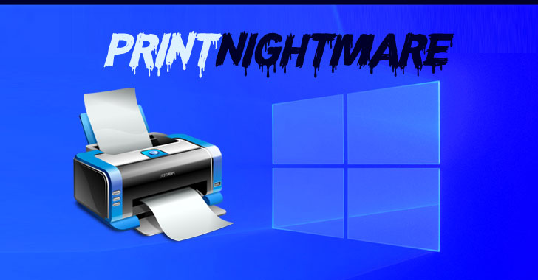
TLDR; PrintNightmare allows Remote Code Execution(RCE) & Local Privilege Escalation on any server or workstation with the Printer Spooler service enabled.
June 2021 – security updates include patch for Printer Spooler vulnerability assigned CVE-2021-1675 considered low severity
June 21, 2021 – Microsoft raises CVE-2021-1675 severity to Critical and classified as an RCE
June 29, 2021 – Security researchers release POC name PrintNightmare they believed to exploit CVE-2021-1675
July 1, 2021 – MS determines that PrintNightmare was actually a new vulnerability referred to as CVE-2021-34527

Slide 5
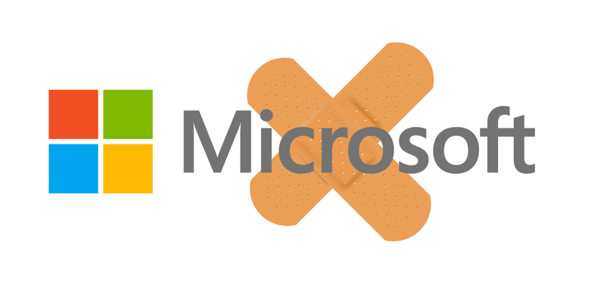
Hello 0-day!!!!!
July 6, 2021 – Emergency patch released to mitigate R E from CVE-2021-34527, but leaves the door open for local privilege escalation.
July 15, 2021 – Microsoft identified new privilege escalation vuln, CVE-2021-034481 with no patch available.
Aug. 10, 2021 – Microsoft releases patches to address CVE-2021-034881 for all operating systems Windows 7 thru 10 and Server 2008 thru 2019
At least we can finally patch the last of the PrintNightmare vulns right?!?!?

Slide 6

Mitigations
Risks
Disable print spooler everywhere
Disable print spooler on Domain Controllers
Disable point & print
Disable user ability to install printers & drivers
Require Admin rights to install a printer
Pre-populate printer drivers on end user stations via SCCM
Install printers on user systems via GPO
End point firewalls restricting network access
THIS IS NOT A ONE-SIZE FITS ALL SCENARIO!
What about 3rd party applications or systems?
How will we support our remote users?
Do we know what printers we have in the enterprise?
Do my users need to print to PDF or XPS?

Slide 7
Detections
Endpoint Detection & Response (EDR) tools are your friend!
Commercial – Carbon Black, Open Source – Sysmon & Velociraptor
Searches
Search for creation of suspicious DLL files spawned in the %WINDIR%\system32\spool\drivers\x64\3\ folder along with DLLs that were loaded afterwards from %WINDIR%\system32\spool\drivers\x64\3\Old\.
Monitor for creation of suspicious files in the %WINDIR%\system32\spool\drivers\x64\ folder.
Monitor for spoolsv.exe spawning werfault.exe due to print spooler service terminating unexpectedly.

Slide 8
Quick before someone notices…

Slide 9
MicroSoft Print Spooler - The gift that keeps on giving!
Aug. 10, 2021 - Security researcher releases PoC to exploit SystemNightmare
https://github.com/GossiTheDog/SystemNightmare
Aug. 11, 2021 – Microsoft publishes CVE-2021-36958 for yet another RCE
Disable your Print Spoolers again!

Slide 10
Hivenightmare (aka – Serious sam & summer of sam)
TLDR; Non-admin users can read the registry (not live but via Volume Shadow Copies)
July 19, 2021 - Vulnerability initially discovered in Windows 11 beta
Researchers quickly discovered that the vulnerability goes back to Windows 10 v1809
July 20, 2021 – @GossiTheDog developed a PoC to exploit the vulnerability
July 20, 2021 – Microsoft creates CVE-2021-36934 for HiveNightmare vuln
Aug. 10, 2021 – Microsoft releases patch to fix HiveNightmare

Slide 11
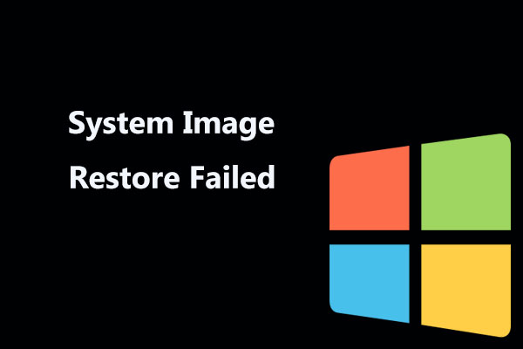
Mitigations
Risks
Restrict access to the contents of %windir%\system32\config
Delete Volume Shadow Copy Service (VSS) shadow copies
Do we have good backups of our end points?
What if my backup solutions relies on Volume Shadow Copies for backup/restore?
Restoring overly permissive ACLs from a restore.

Slide 12
Detections
Endpoint Detection & Response (EDR) to the rescue again!
Commercial – Carbon Black, Open Source – Sysmon & Velociraptor
Monitor for suspicious actions against the HKLM System, Security and SAM databases
SIEM & Sysmon example:
windows_log_source="Microsoft-Windows-Sysmon" AND process_name LIKE "%reg.exe%" AND REGEXP_CONTAINS(command, "HKLM\\\\system|HKLM\\\\security|HKLM\\\\sam")

Slide 13
How bad can it be?

Slide 14
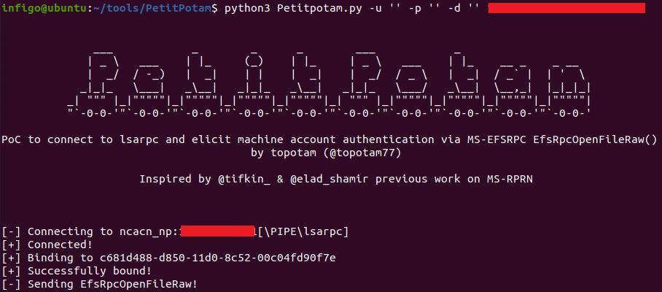
July 21, 2021 – Security researcher develops PoC tool named PetitPotam that is used to perform NTLM Relay Attack
Exploits MS-EFSRPC (Encrypting File System Remote (EFSRPC)) protocol to get a system to authenticate to an imposter system
Chained vulnerabilities are then used to relay NTLM to AD CS and then fetch a Kerberos Ticket Granting Ticket and then get the keys to the kingdom
July 23, 2021 – Microsoft publishes advisory ADV210003 providing guidance on how to mitigate the attack
Prerequisites
NTLM authentication enabled
AD Certificate Services with either of the following:
Certificate Authority Web Enrollment
Certificate Enrollment Web Service

Slide 15
Mitigations
Risks
Enable EPA and disable HTTP on AD CS servers.
Enable EPA for Certificate Enrollment Web Service.
Disable NLTM authentication on Domain Controllers
Disable NTLM on any Active Directory Certificate Services server
Disable NTLM for IIS on any Active Directory Certificate Services server
Do your homework. Don’t break your environment!
What relies on NTLM in my org?
How will disabling NTLM affect legacy systems?

Slide 16
Detections
look for events with Event Code 4768 (TGT request), where the Certificate Information section contains data (Certificate Issuer Name, Serial Number and Thumbprint), indicating that a certificate was used for request.
Where is the certificate from?
Do you recognize the PC requesting the TGT
Your SIEM is your friend!

Slide 17
Questions?
Get some sleep! Nightmares only come if you let them.

Slide 18
Reference
PrintNightmare
https://www.sygnia.co/demystifying-the-printnightmare-vulnerability
https://www.ultimatewindowssecurity.com/webinars/register.aspx?id=2662
https://www.splunk.com/en_us/blog/security/i-pity-the-spool-detecting-printnightmare-cve-2021-34527.html
https://github.com/GossiTheDog/SystemNightmare
HiveNightmare
https://doublepulsar.com/hivenightmare-aka-serioussam-anybody-can-read-the-registry-in-windows-10-7a871c465fa5
https://github.com/GossiTheDog/HiveNightmare
https://isc.sans.edu/forums/diary/Summer+of+SAM+Microsoft+Releases+Guidance+for+CVE202136934/27656/
https://blog.malwarebytes.com/exploits-and-vulnerabilities/2021/07/hivenightmare-zero-day-lets-anyone-be-system-on-windows-10-and-11/
https://www.blumira.com/sam-database-vulnerability/
PetitPotam
https://borncity.com/win/2021/07/25/microsoft-liefert-workaround-fr-windows-petitpotam-ntlm-relay-angriffe/
https://www.deepwatch.com/labs/petitpotam-ntlm-relay-attack/
https://isc.sans.edu/forums/diary/Active+Directory+Certificate+Services+ADCS+PKI+domain+admin+vulnerability/27668

Slide 19
Empowering individuals and organizations to protect themselves and fight the good fight!

